Slide 1
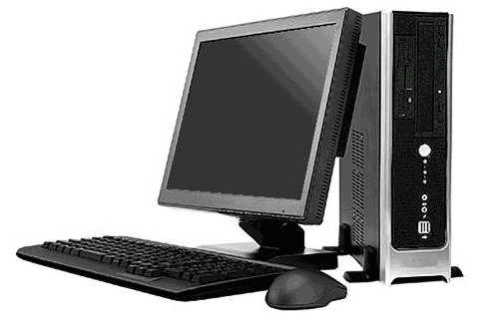
PERSONAL COMPUTERS
PRESENTED BY
SIDDHARTH SHAH & MAYUR PRAJAPATI

Slide 2
Overview
Personal Computers are electronic devices. The user inputs the data for calculation and the computer gives the output.
computer can perform storing data, processing data and moving and communicating the different data .

Slide 3
INTRODUCTION
Personal Computers (PC) are electronic gadgets that performs the same function a human does on an information/data in an amazing speed

Slide 4
How the computer works?
The system software tells the CPU to start up certain programs .
The first process is Hardware components check
The second process is called booting up
The next step happens when you choose a program you want to use.
CONTINUE….

Slide 5
PRIMARY FUNCTIONS OF COMPUTER
Storing the data
short term storage - is the system memory that holds the data that you or the system working with right now.
Long term storage - is provided by the hard disk drive, like floppy, drives and other devices and is stored permanently in the form of files.
CONTINUE….

Slide 6
Processing the data
The key part of the computer that processes information is the processor.
The computer translates data from one form to another.
CONTINUE….

Slide 7
Movement the data
The computer reads the information, moves it into memory and displays it on the screen or stores it in a file.
This movement is called input/output or I/O process.
CONTINUE….

Slide 8
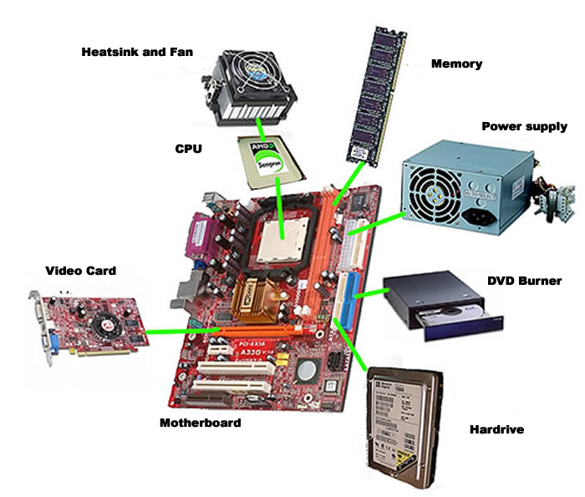
Systems and Components – An Overview
CONTINUE….

Slide 9
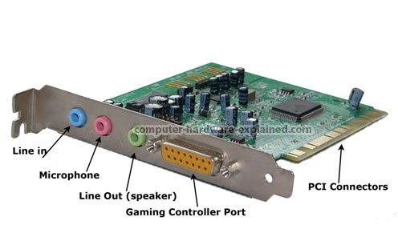
The Motherboard : hold the computer hardware subcomponents
Ram Memory : is used to provide temporary storage of information
Microprocessor : is used to provide the processing of data function
Video card : is an interface between the computer monitor and the motherboard
Hard disk : is used to provide permanent storage of data
CD Rom : CD drive or DVD drive is used to provide permanent storage of data
SOUND CARD : is an interface between the computer speakers and the motherboard
CONTINUE….

Slide 10
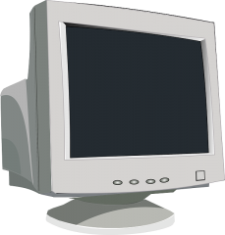
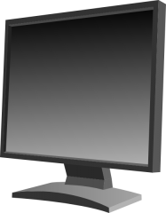
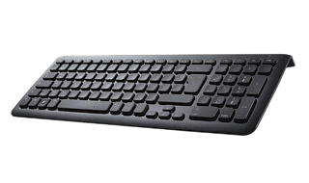
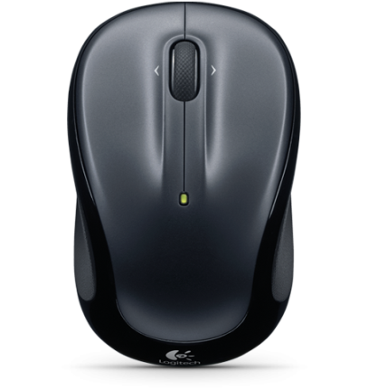
MONITOR : is an output device that displays the data/information in graphical form
CPU : is the system case that houses several internal operating mechanisms
KEY-BOARD : is an input device similar to a kind of a typewriter
MOUSE : helps to activate certain things on the monitor
CONTINUE….

Slide 11
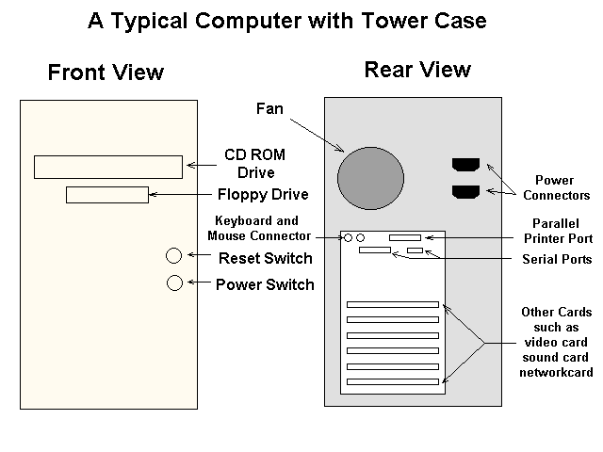
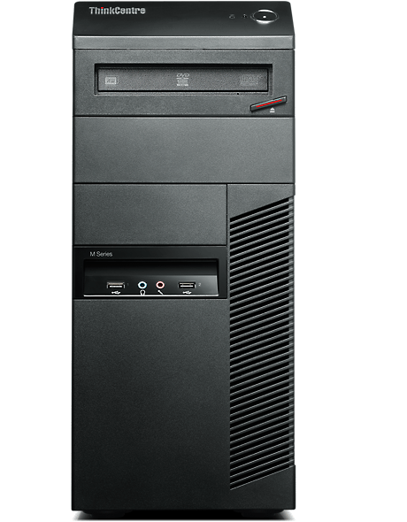
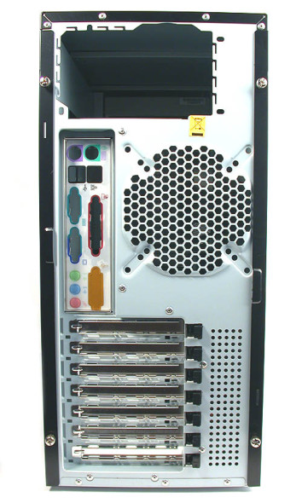
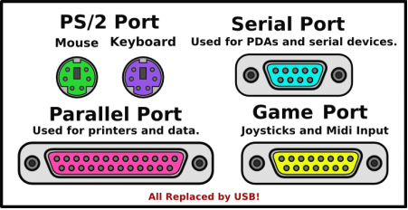
SYSTEM Case : is the outside component which provides protection for the parts inside.
CONTINUE….

Slide 12
Conclusion
Personal computers takes in the data from the user (input), processes and returns (output) it to the user in the desirable form.
It performs heavy and complex math operations through a set of instructions called Programs.
Computers are digital and use binary numbers to allot space in the memory.

Slide 13
ANY QUESTIONS ?

Slide 14


